Slide 1
Knowledge Inventory for hydrogeology research
The KINDRA - Harmonised Groundwater Research Classification System (HRC-SYS)
and
European Inventory of Groundwater Research (EIGR)
Klaus Hinsby, Eurogeosurveys/GEUS and
Marco Petitta, European Federation of Geologists/Uni. Sapienza
(coordinator , coordinator@kindraproject.eu)
Notes:
Describe already on this slide the ideas behind the project – e.g. that EFG and EGS noted that groundwater was not mentioned in Horizon 2020 and that we decided to find a way to put some emphasis on groundwater and hydrogeology by demonstrating the wide range of groundwater/hydrogeology research and its relevance for many of the H2020 societal challenges

Slide 2
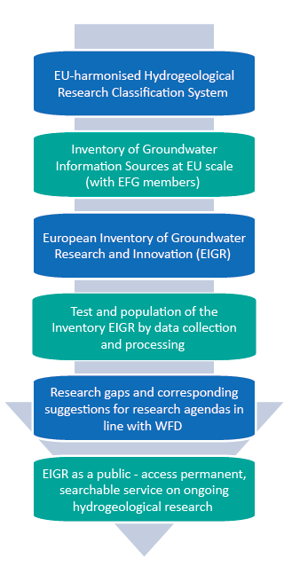
Aims of the project (2015-2017)
- KINDRA -
Knowledge Inventory for Hydrogeology Research
To create an inventory of GW knowledge and use the inventory to identify critical research challenges in line with the implementation of the WFD and new innovation areas within integrated water resources management based on the latest research.

Slide 3
Project organisation
WP4 - Dissemination and communication (LPRC)
Dissemination and management
Dissemination and support services
Leveraging dissemination and dialogue
WP1 - Methodology framework development (SAPIENZA)
harmonised framework for reporting hydrogeology-related research and innovation (programmes, projects, results, agendas, etc) in Europe:
Hydrogeological Research Classification System – HRC – SYS
European Inventory of Groundwater Research- EIGR
WP2 - Data collection and processing (EFG)
EU- wide assessment of existing practical and scientific knowledge on hydrogeology-related research and innovation in Europe:
National workshops on Hydrogeology
Data collection and processing
country reports
WP3 - Research gaps and recommendations (GEUS)
Identify research gaps in hydrogeology research that have relevance for the implementation of the Water Framework and Groundwater Directives (WFD and GWD)
Hydrogeology research evaluated
Research gaps identified
Recommendations formulated
WP5 - Project management (SAPIENZA)
Quality Assurance and Risk Management
Project Coordination
Project management
Exploitation of results and IPR

Slide 4
Added values of KINDRA EIGR:
07
The KINDRA inventory are exclusively dedicated to groundwater, differently from other databases
Combining research and knowledge enables and ensures access and relevance for academics, practitioners and policy makers
A dedicated classification system has been created to classify your research, papers, projects, reports, databases, etc.
It is developed BY and FOR hydrogeologists and other "groundwater people”, to promote networking and enlarge our community
It provides harmonised international access to information on national and European research and knowledge before research is finally published
Database analyses will be used for EU policy support
and to increase the visibility and awareness of the importance of groundwater research in the societal challenges

Slide 5
How to classify groundwater research?
Research topics
Keywords
Societal challenges
EU policies
Other ????
Actions

Slide 6
More than 200 main keywords were selected from:
20 key groundwater science journals
Scopus / Web of Science / Google Scholar
EU policy documents (Water Framework and Groundwater directives, Blueprint to Safeguard Europe’s Water Resources)

Slide 7
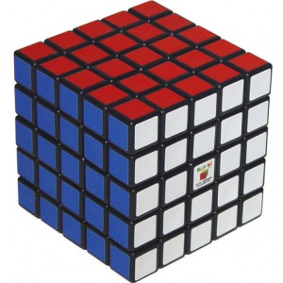
How to classify groundwater research (in Europe)?
Horizon 2020 Societal challenges
Activities/ operational actions
(e.g. status assessment for WFD)
Research topics

Slide 8
Definition of main categories for groundwater research classification
4
5
3
1
2
SC
4
5
3
1
2
OA
4
5
3
1
2
RT

Slide 9
3D conceptual illustration of main categories of groundwater research classification and scientific output
Societal challenges
Policy & innovation
Climate & environ.
Energy
food
health
Mapping
monitoring
modelling
Geology
Operational
actions
Water supply
Math & phys
Operational actions
Geography
Biology
Chemistry
Research topics

Slide 10
Example: 2D PLOT FOR SC1: HEALTH
SC1: Health
OA4: Water supply
RT2: Chemistry

Slide 11
Knowledge Inventory for hydrogeology research
The European Inventory
of Groundwater Research
-EIGR-
Notes:
Describe already on this slide the ideas behind the project – e.g. that EFG (and EGS) noted that groundwater was not mentioned in Horizon 2020 and that we decided to find a way to put some emphasis on groundwater and hydrogeology by demonstrating the wide range of groundwater/hydrogeology research and its relevance for many of the H2020 societal challenges

Slide 12
The EIGR is initially populated by the following national experts of the EFG:
05
 | Country | Organisation | Expert’s name
1 | Belgium | Belgo-Luxembourg Union of Geologists | (1) Alain Dassargues (2) Dirk de Coste
2 | Croatia | Croatian Geological Society | Kosta Urumović
3 | Czech Republic | Czech Association of Economic Geologists | Michal Vaněček
4 | Denmark | Geological Society of Denmark | Lisbeth Flindt Jørgensen
5 | Finland | The Finnish Union of Environmental Professionals | Ulpu Väisänen
6 | France | French Geological Society | Patrick Lachassagne
7 | Germany | Professional Association of German Geoscientists | Walter Lenz
8 | Greece | Association of Greek Geologists | Triantafillos Kaklis
9 | Hungary | Hungarian Geological Society | Nóra Gál
10 | Ireland | Institute of Geologists of Ireland | Henning Moe
11 | Italy | Italian National Council of Geologists | Andrea Del Bon
12 | The Netherlands | Royal Geological and Mining Society of the Netherlands | Jan Stafleu
13 | Poland | Polish Association of Minerals Asset Valuators | Barbara Tomaszewska
14 | Portugal | Portuguese Association of Geologists | Mónica Sousa
15 | Serbia | Serbian Geological Society | Vesna Ristic Vakanjac
16 | Slovenia | Slovenian Geological Society | Mihael Brenčič
17 | Spain | Official Spanish Association of Professional Geologists | Silvino Castaño Castaño
18 | Switzerland | Swiss Association of Geologists | Pierre Christe
19 | Ukraine | Ukrainian Association of Geologists | Alexander Bobrov
20 | United Kingdom | Geological Society of London | Andy McKenzie

Slide 13
Resource types for population of the EIGR (only metadata):
07
Research and applied research projects (e.g. EU and Interreg projects)
Technical reports and guidances
Books and book chapters
Surveys including relevant data and maps
Consulting reports for ministries and other authorities
Monographs etc., etc.,

Slide 14
Classification of ‘research’ and ‘knowledge’ based on the degree of Quality Assurance
08

Slide 15
The EIGR user interface - for groundwater research upload and viewing
13
http://kindra.kindraproject.eu/geonetwork/srv/eng/main.home

Slide 16
Thank You ☺
The KINDRA project group invites everybody to upload information on groundwater research and knowledge to the EIGR at:
http://kindra.kindraproject.eu/geonetwork/srv/eng/main.home
www.kindraproject.eu
Email: coordinator@kindraproject.eu

